Slide 1
Image Feature Detection
Eslam Ahmed – Yara Mahfouz – Mariam Barakat

Slide 2
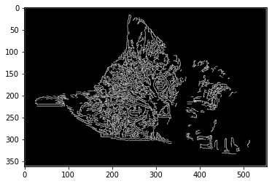
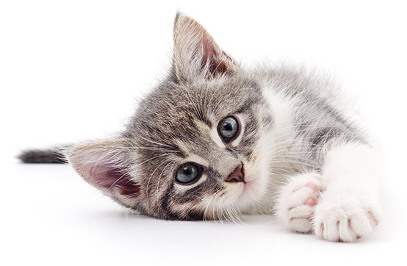
Canny Edge detection
An edge detection operator

Slide 3
Steps of the Algorithm
1. Noise reduction
2. Gradient calculation
3. Non-maximum suppression
4. Double threshold
5. Edge Tracking by Hysteresis

Slide 4
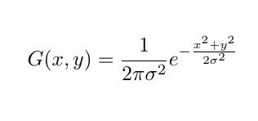
1. Noise Reduction
Gaussian Blur
Reduce noise so it isn’t mistaken as edges
Create our Kernel by choosing the standard deviation
Pass it on our image

Slide 5


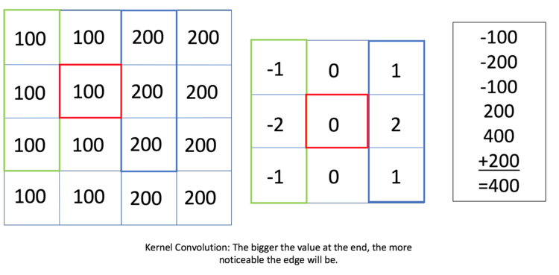
2. Gradient Calculation
Sobel operator
Find direction and intensity of edges
Pass the kernels on x and y
Find the gradient
Find the theta

Slide 6
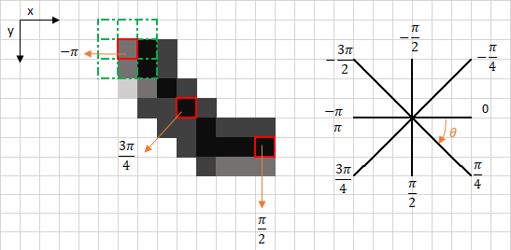
3. Non-maximum suppression
Convert the blurred edges to sharp edges
Round the gradient direction θ to nearest 45◦ , corresponding to the use of an 8-connected neighborhood.
Compare the edge strength of the current pixel with the edge strength of the pixel in the positive and negative gradient direction.
If the edge strength of the current pixel is largest; preserve the value of the edge strength. If not, suppress the value.

Slide 7
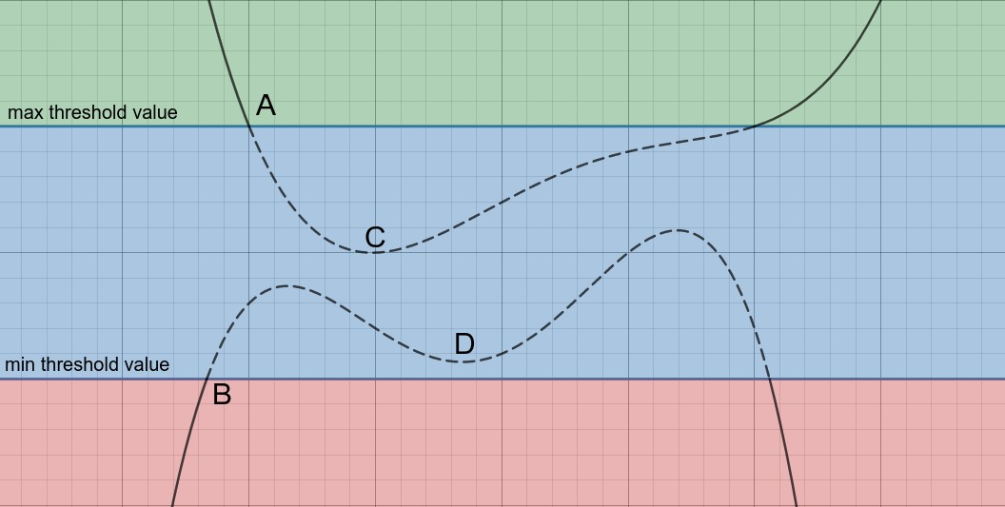
4. Double Thresholding
Result of Non-maximum may result in some extra edges
Edge pixels stronger than the high threshold are marked as strong
Edge pixels between the two thresholds are marked as weak
Edge pixels weaker than the low threshold are suppressed

Slide 8
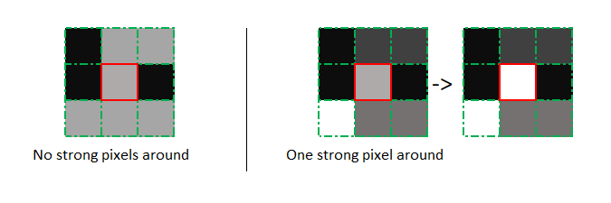
5. Edge tracking by Hysteresis
Strong edges are interpreted as “certain edges” and can immediately be included in the final edge image.
Weak edges are included if and only if they are connected to strong edges.

Slide 9
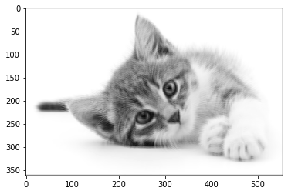
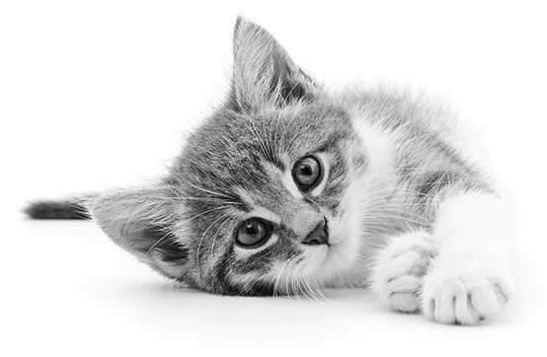
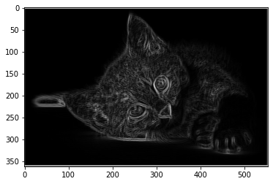
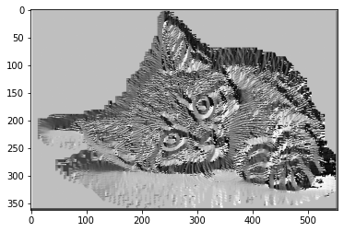
Stages of the pictures
Noise Reduction
Original picture
Gradient calculation

Slide 10
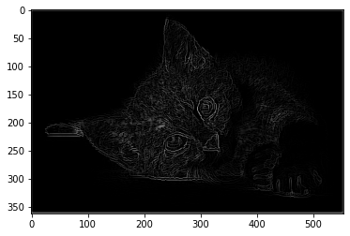
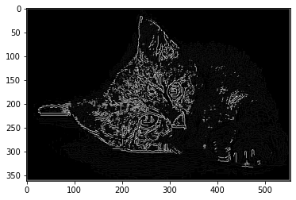
Non-maximum suppression
Double Threshold
Edge Tracking

Slide 11
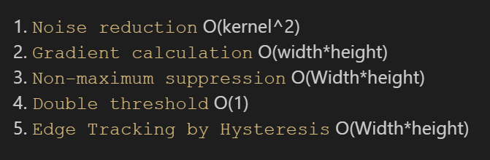
Complexity

Slide 12
K-Means Clustering

Slide 13
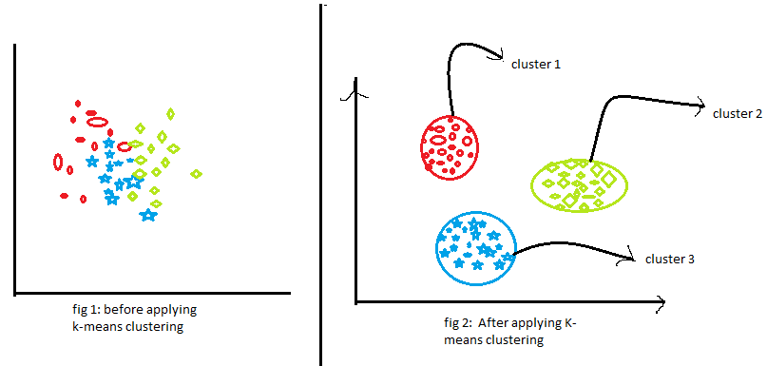
Clustering
Clustering is the task of dividing the population or data points into a number of groups such that data points in the same groups are more similar to other data points in the same group than those in other groups. In simple words, the aim is to segregate groups with similar traits and assign them into clusters.

Slide 14
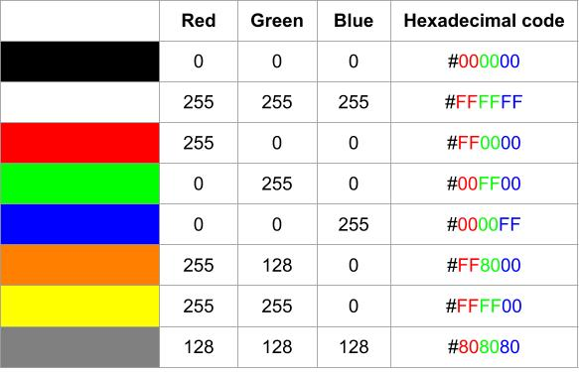
Images and Colors representation
An image is made of many pixels, each of them with a particular color
It is impossible to store each one of these colors personally, they are instead represented as a combination of three primary colors: red, green, and blue (RGB color model).
for each pixel, we need to store a total of 3 numbers corresponding to the amount of each color.
each color can get 256 values (from 0 to 255), 0 being the absence of the color and 255 the highest intensity of it.

Slide 15
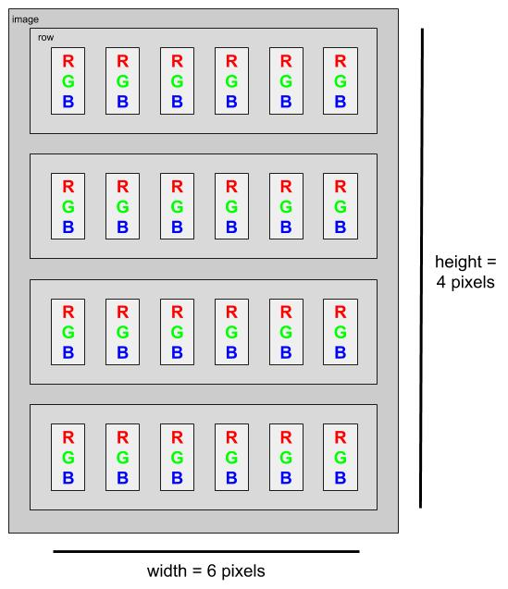
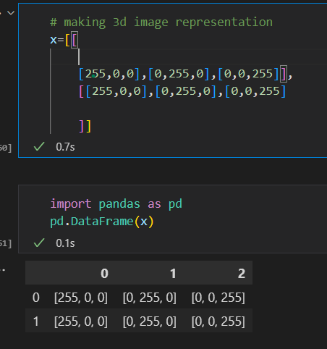
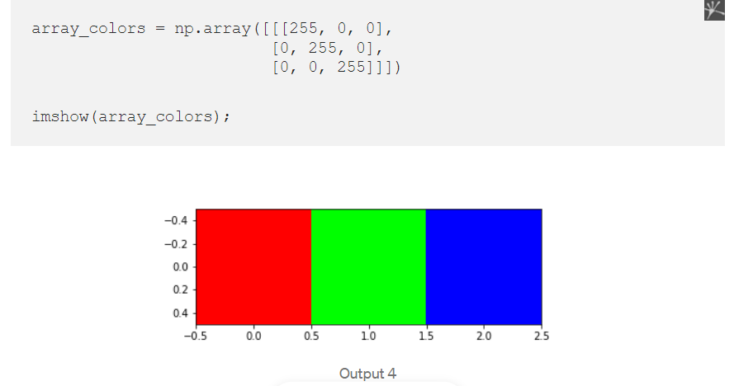
Image Representation as a Matrix
Image consists of 3 dimensions

Slide 16
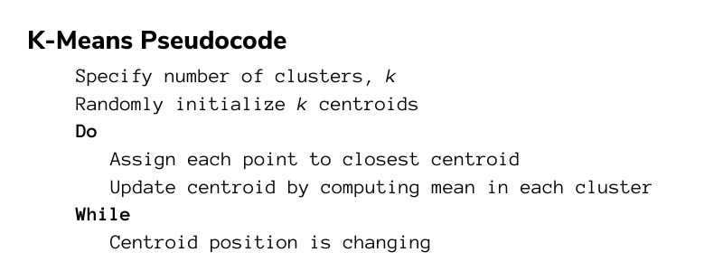
K means pseudocode

Slide 17
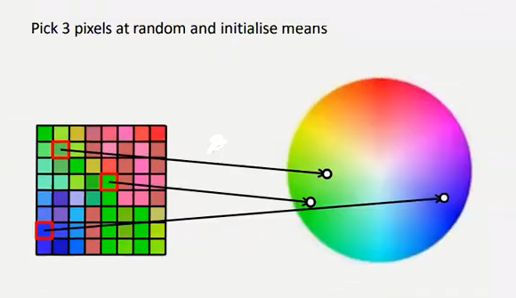
Steps of K means segmentation (same as original but we deal with pixels
We plot all pixels in the color space
We take K number of random pixels/centroids (assuming they are 3)

Slide 18
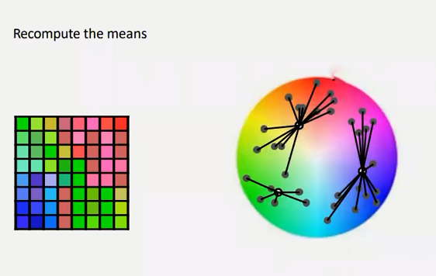
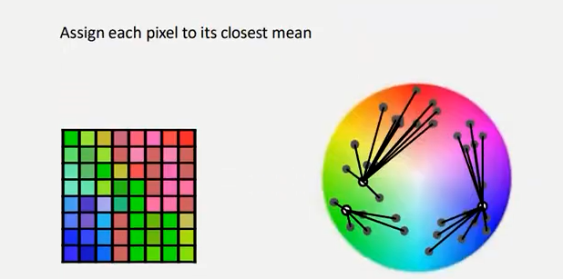
3. Image is scanned and each pixel(point) is assigned to its nearest cluster (nearest K value which is nearest color

Slide 19
4. Calculate the mean of the pixel(centroid) and update its position (its color may change 3ady

Slide 20
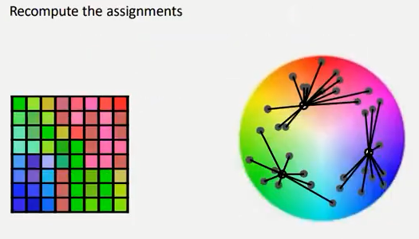
5. Repeat step number 3 until the mean of the updated centroid in the n iteration is the same in n-1 iteration

Slide 21
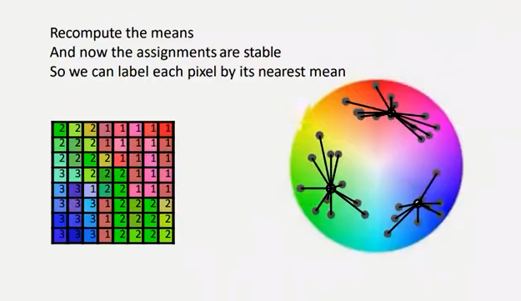
6. Label each pixel according to its nearest mean (convert its color to the color of the centroid/pixel color) and we will have a 3 segments/colors image

Slide 22
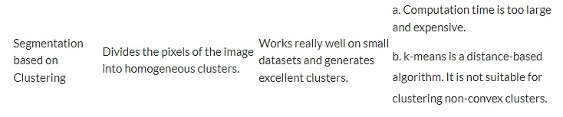
Advantages and limitations
K-means Complexity
It computes results at O(tkn)
Where k is the number of clusters and n is the number if points or pixels and t is the number of iterations.

Slide 23
Image segmentation using graph cuts

Slide 24
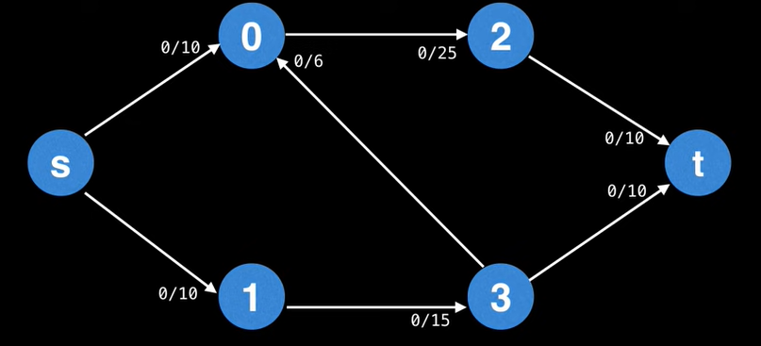
Flow networks
A directed graph with two distinguished nodes called S for source and T for sink
Each edge in the graph has a certain capacity which can receive certain amounts of flow

Slide 25
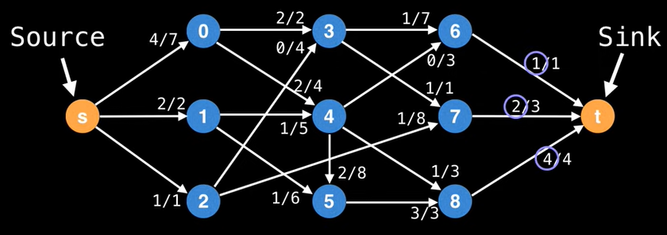
Max Flow / Min Cut problem
The goal is to find the maximum amount of flow that can be delivered from source to sink while satisfying the following constraints:
Flow going through an edge must be less than or equal to each edge’s capacity
conservation law; flow going into a vertex must be equal to flow coming out of it

Slide 26
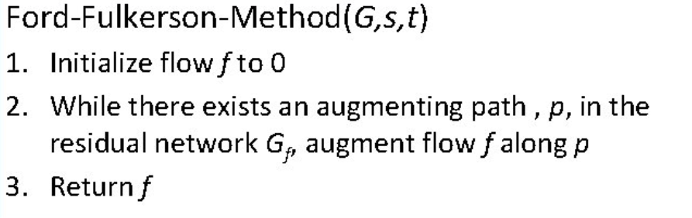
Ford-Fulkerson Method
To find the maximum flow, the ford-Fulkerson method repeatedly finds augmenting paths through the residual graph and augments the flow until no more augmenting paths can be found.

Slide 27
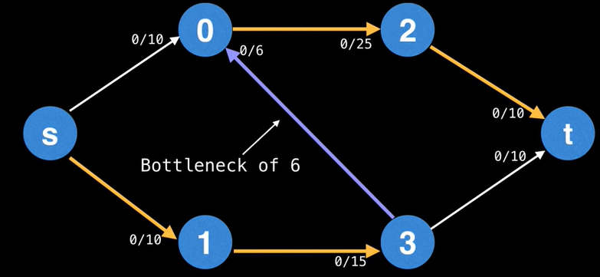
Ford-Fulkerson Method
Augmenting path:
a path of edges in the residual graph with unused capacity from source to sink.
Each path has a bottleneck value which is the lowest edge capacity that belongs to the path, and it is the value used for augmenting the flow.

Slide 28
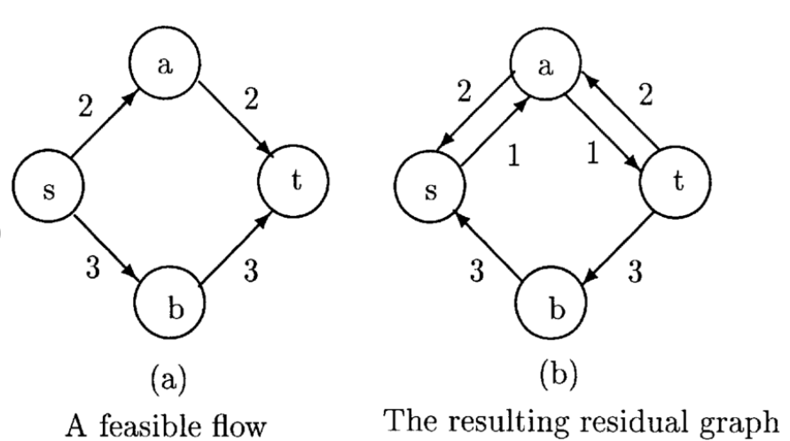
Ford-Fulkerson Method
Residual graph:
A graph that keeps track of the used capacity as well as the remaining capacity for each flow augmentation.
Capacity of all edges = 3

Slide 29
Ford-Fulkerson Method
Min cut
The minimum cut of a weighted graph is the minimum sum of weights of edges that, when removed from the graph, divide the graph into two sets.
Max flow
The maximum flow is obtained once there are no more augmentation paths available, and the flow value is equal to the sum of all the bottleneck values in each path.
It can be observed that by finding the max flow of a flow network, we also find the min cut of the graph.

Slide 30
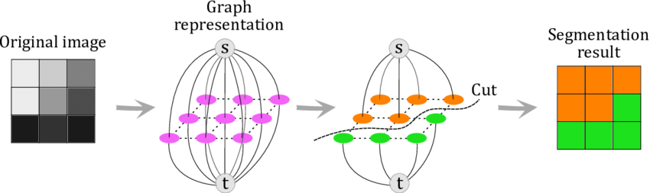
Graph cut segmentation
An image segmentation method that converts an image to a graph then uses tools from graph theory to partition foreground from background

Slide 31
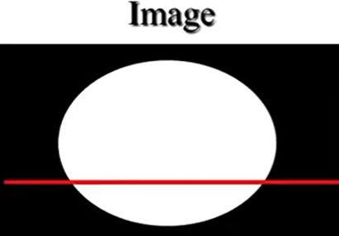
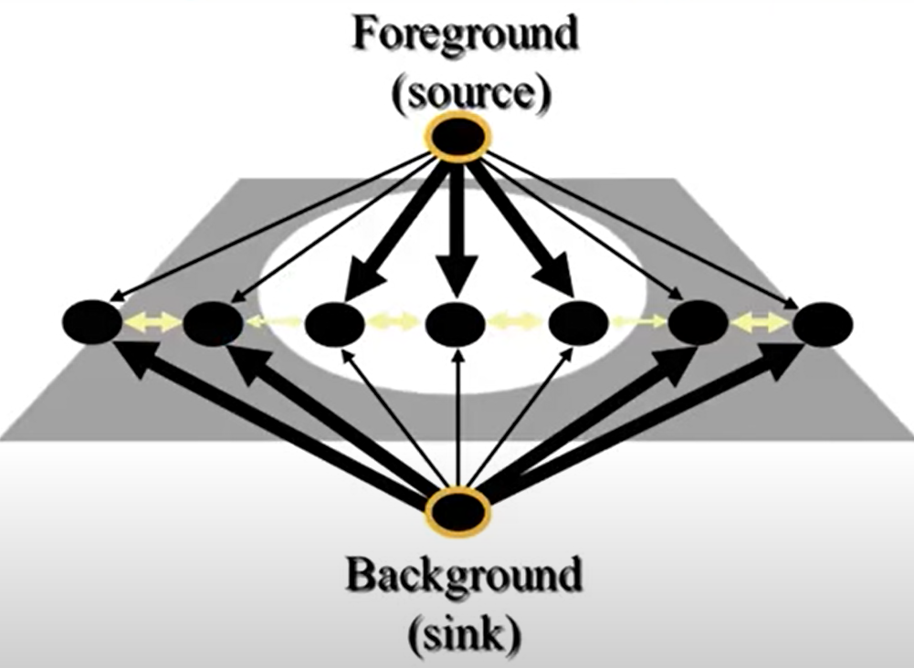
Graph cut segmentation
Image to Graph
- Each pixel in the image is a vertex in a graph, with two additional vertices that serve as source and sink (foreground and background)
There are Two types of edges in our graph:
1 - The first type is called n-links, which connects neighboring pixel vertices.
2 - The second type of edges is called t-links, which connect the source or sink vertex with the pixel vertices.

Slide 32

Graph cut segmentation
N-links
N-links edges weights are computed in a way that reflects their inter-pixel similarity, the weights are small when pixels are different and large when pixels are similar
Above is the equation for determining n-link edge values, where Ip is the brightness of the pixel vertex P.
The choice of the function is determined by the series of trial and error, such that it produces a small value when the difference between the two pixels intensities is large, and vice versa.

Slide 33
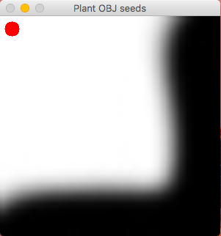
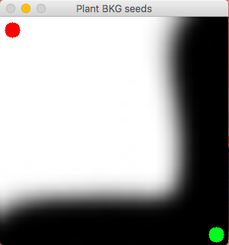
Graph cut segmentation
T-links
To make t-links, the user is prompted to highlight at least one pixel vertex as a background pixel and at least one as a foreground pixel (seeds), then an edge is added from the source/sink to that seed.
So, the seeds are hard-coded to be either the foreground or the background.

Slide 34
Graph cut segmentation
Min cut segmentation
Ford-fulkerson method does not specify which approach is used to find augmenting paths.
Edmonds-Karp Algorithm is an implementation of ford-fulkersons that uses bfs to get the max flow.
Since we are interested in min cut, a depth first search is also performed on the residual graph to obtain the min-cut edges.
and we are interested in the min cut for segmentation because edge values are lowest when pixels are different, so the min cut is essentially the separating line between foreground and background.

Slide 35
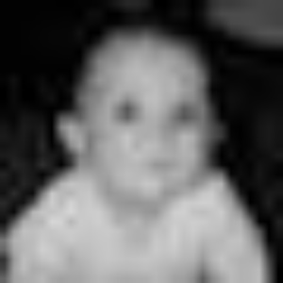
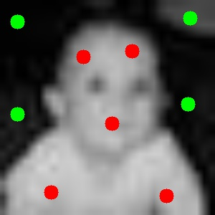

Graph cut segmentation
Results

Slide 36

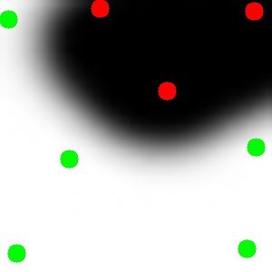

Graph cut segmentation
Results

Slide 37
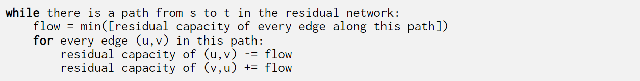
Graph cut segmentation
Time complexity
An augmenting path can be found in O(E), and the length of such path is O(V), since every iteration at least one edge becomes fully saturated, the total number of times we can find an augmenting path is bounded by O(VE).
The body of the while loop runs in O(E) time, so in total the time complexity is O(VE^2)

Slide 38
References
https://julie-jiang.github.io/image-segmentation/#algos
https://www.youtube.com/watch?v=HMGX8HXskKk
https://www.youtube.com/watch?v=LdOnanfc5TM&t=471s
https://www.youtube.com/watch?v=VYZGlgzr_As
https://docs.opencv.org/4.x/da/d22/tutorial_py_canny.html
https://www.youtube.com/watch?v=sRFM5IEqR2w

